Slide 1
DS Project
Spell checker

Slide 2
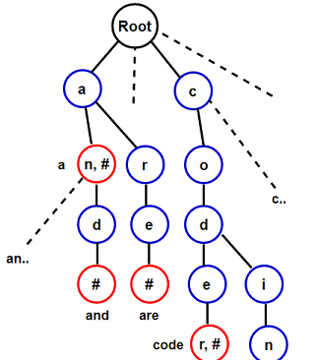
Trying to understand
What is a "TRIE"
A trie is a tree-like data structure where in the nodes of the tree store the entire alphabet,
and
string/words can be retrieved by traversing down a branch path of the tree

Slide 3
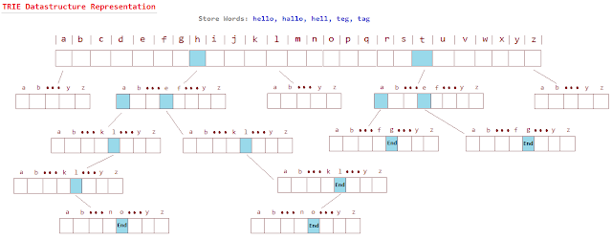
TITLE GOES HERE
DS PROJECT
SUBTITLE GOES HERE
From root the array of pointers then points to subsequent positions on following arrays
Which then at the end points to a null filled alphabet array that has the end key.

Slide 4

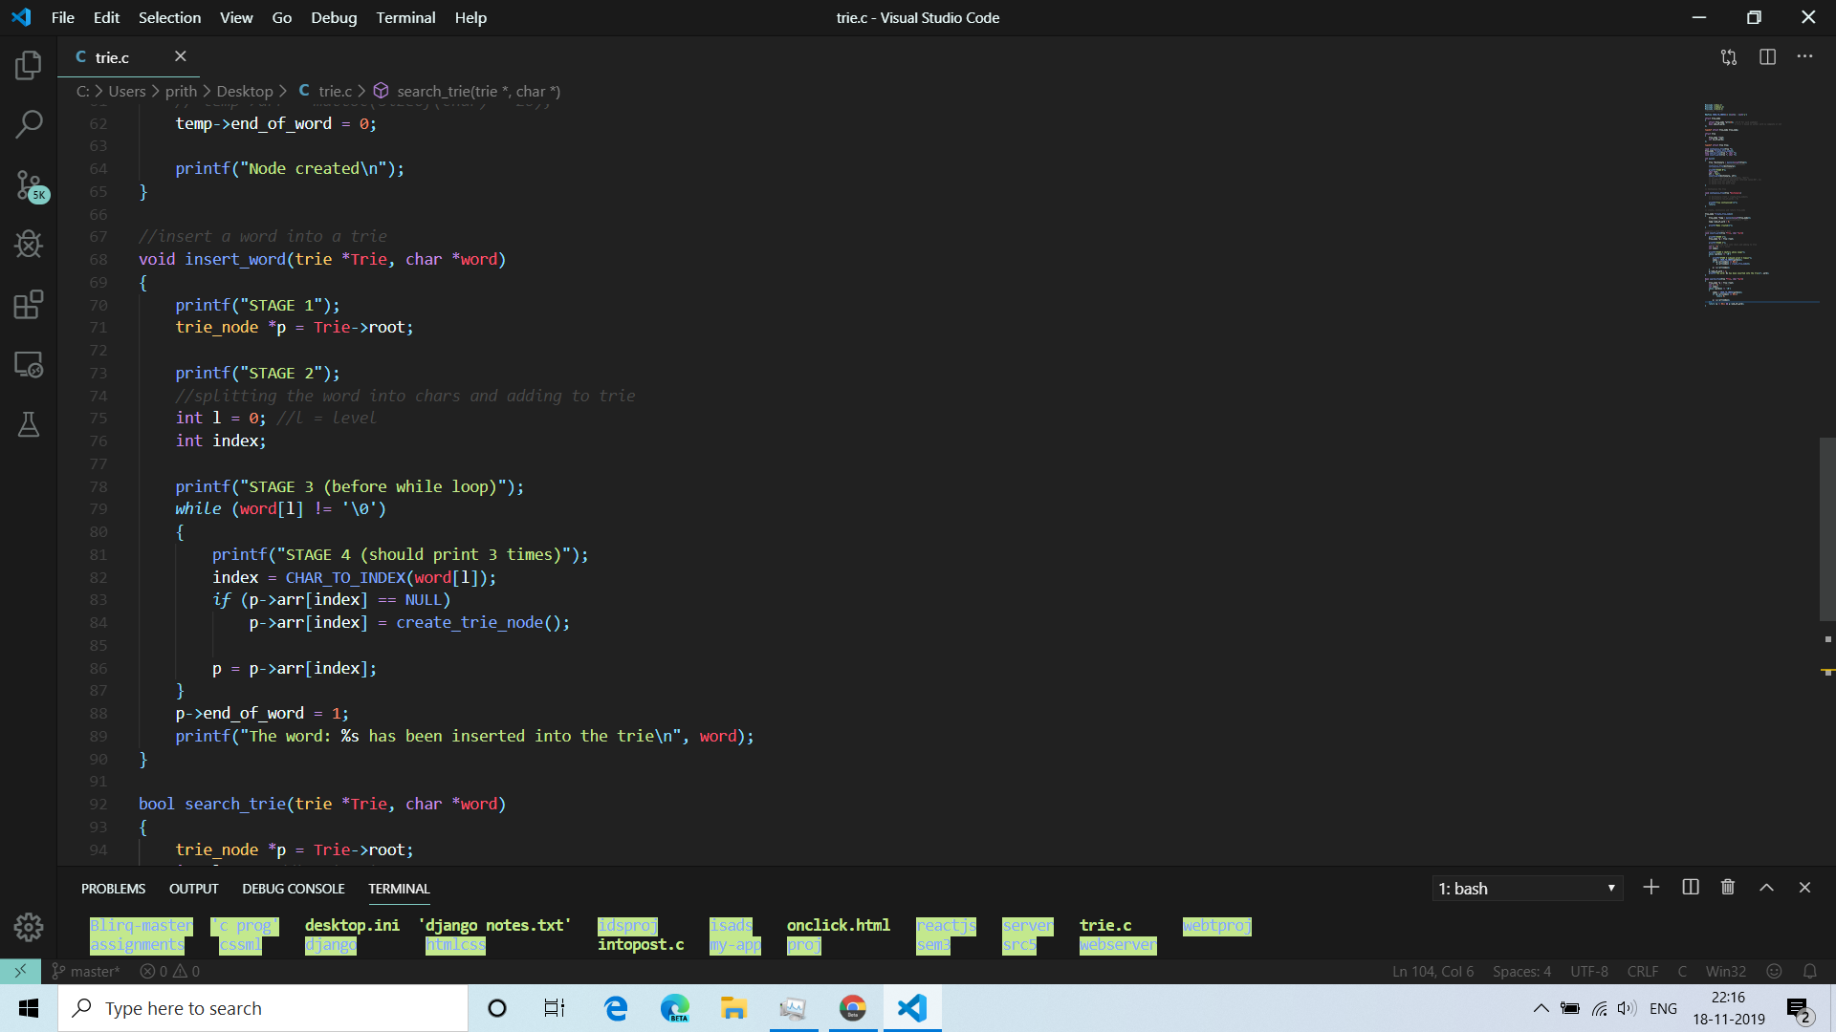
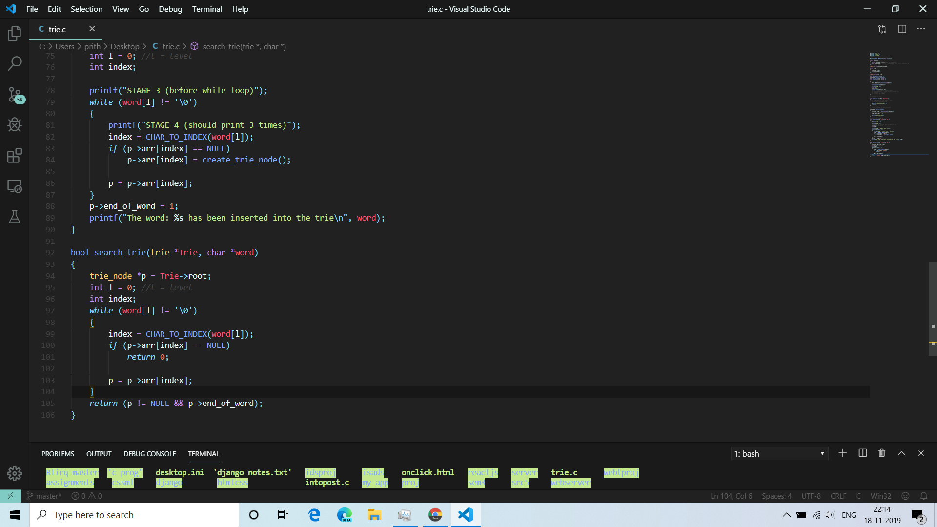
Operations on trie
4
insert which inserts a new key/value and yield a new updated Trie.
delete which removes a key/value if it exists and creates a new Trie.
search which returns true if key presents in trie, else false.
Timecomplexity 0(n) .

Slide 5


SPELL CHECKER
How to perform spell checker operation on trie.
1. we take in a dataset that contains all the words , which is also called as a dictionary.(from a text file)
2. we then insert/take in user input of the word to be checked.
3. we then search and see if the word exists in our inserted trie dictionary.
DS PROJECT

Slide 6
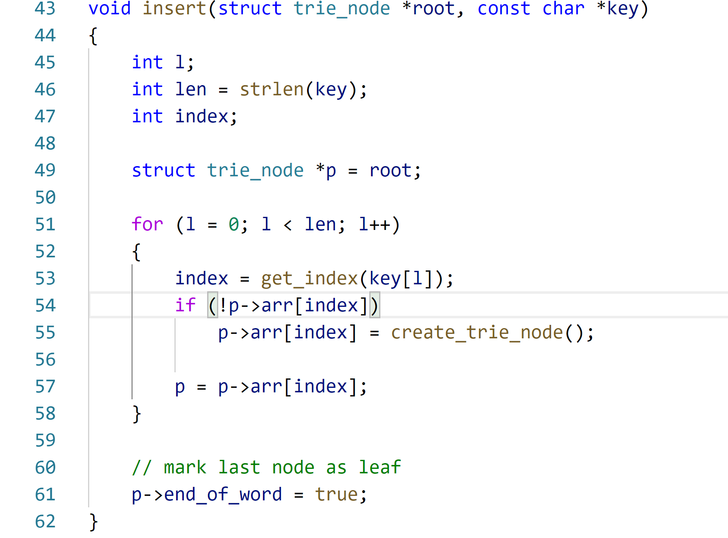
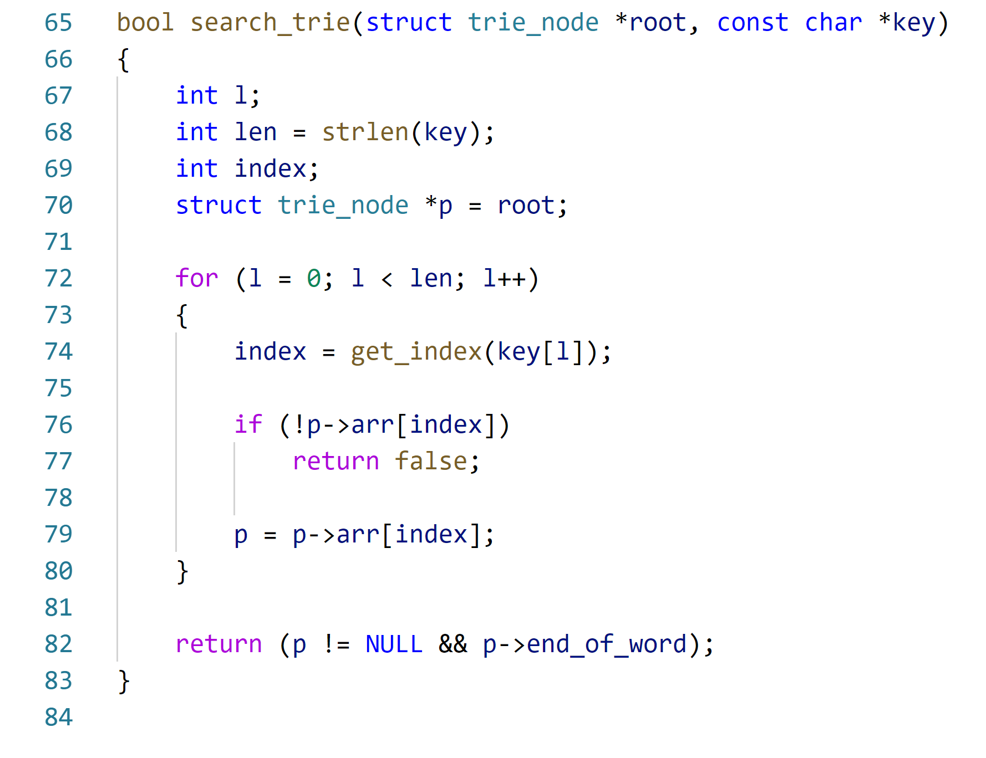
Insert into trie
FUNCTIONS
Search trie

Slide 7
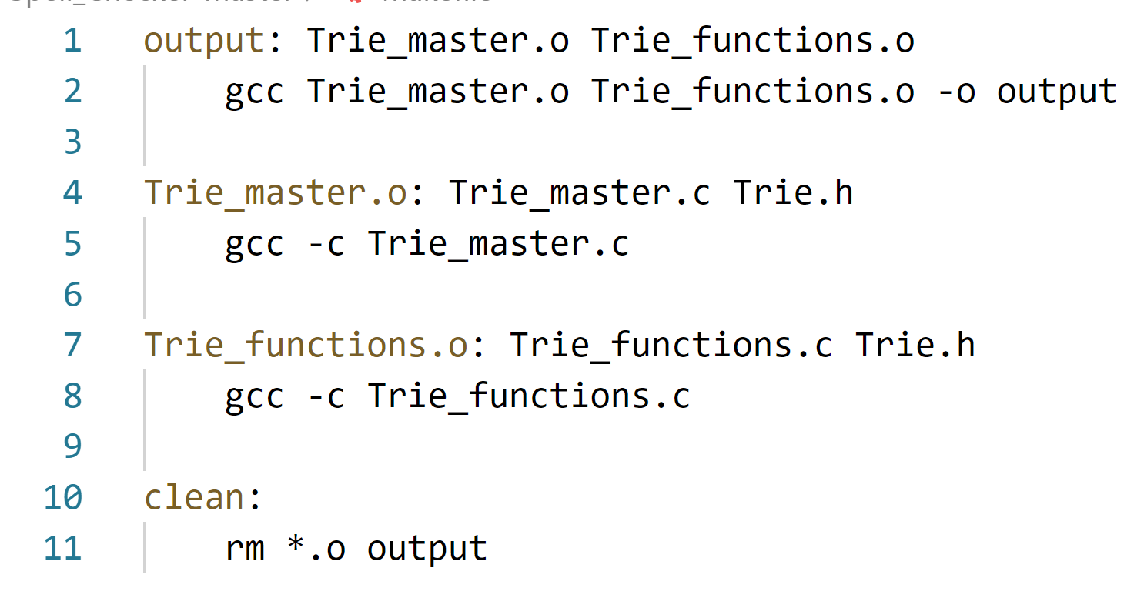
Make files
What is make
In software development, Make is a build automation tool that automatically builds executable programs and libraries from source code by reading files called Makefiles which specify how to derive the target program.
DS PROJECT

Slide 8
THANK YOU
DS PROJECT
Prithvi raj –srn PES2201800307
Venkatavaradan R –srn PES2201800307

